Slide 1

Cross validation in machine learning
Presented by :-
Hrishikesh Deshpande
ads

Slide 2
What is cross validation in machine learning ?
Cross-validation is a technique in which we train our model using the subset of our data-set and then evaluate that using the complementary subset of the data-set. Mainly, we use one part for training and one part for testing.
Like, we should not only train but test also for our model. We should remain some part for testing our dataset.
Steps in cross validation :
1. Reserve some portion of given sample dataset for testing purpose for model.
2. using the rest dataset to train our model.

Slide 3
Which are the methods of cross validation ?
There are three methods for cross validation.
But in first 2 , there are some disadvantage so we preferably use 3rd method for validation.
1. Validation
2. LOOCV (Leave one out cross validation)
3. K-fold cross validation

Slide 4
1. validation : here, we divide our dataset into 50% training and 50% testing.
But, if we use 50% data for training then there might chances that remaining 50% of testing data may contain important data which is important for prediction for new values.
so, due to this, underfitting prob. May occur like high biased.
To overcome this advantage we use next method which is loocv.
2. loocv (Leave one out cross validation) : here, we use more like 99% data for training and remain 1% data for testing.
In this method, we perform training on the whole data-set but leaves only one data-point of the available data-set and then iterates for each data-point.

Slide 5
E.g. if we have 10 datapoints so,
1st iteration : 9 for training , 1 for testing.
2nd iteration : 9th datapoint for testing, remaining for training.
3rd iteration : 8th datapoint for testing, remaining for training.
4th iteration : 7th dataoint for testing, remaining for training……upto nth iterations.
Like this, all data will get trained and tested.
Advantage : low bias because we have trained all data.
Disadvantage : it leads for higher variations for testing because we are testing for each dtpoint.
Iterations will be more. High computation rate.
More execution time as it operates on iterations n times.

Slide 6
3. K-fold cross validation :
In this method, we split dataset into k- times (k parts). Then we perform training on all subsets.
we split the data-set into k number of subsets(known as folds) then we perform training on the all the subsets but leave one part(k-1) subset for the evaluation of the trained model. In this method, we iterate k times with a different subset reserved for testing purpose each time.
This is most used method for cross validation.
E.g. we have 100 datapoints (100 rows),
then, instead only 1 keeping for testing & rest for train , we divide our dataset in 10 parts so, here K = 10.
then 90% we use for training and rest for testing.
2nd iteration : we include 10 % testing into training from previous iteration and remaining for testing
Other 10% for testing and remaining more will be in training.
This is how k fold works.

Slide 7
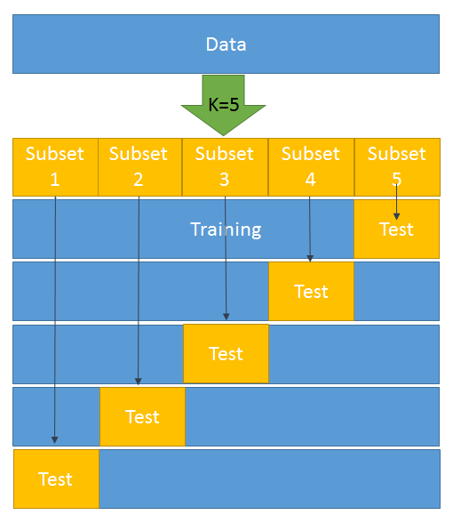
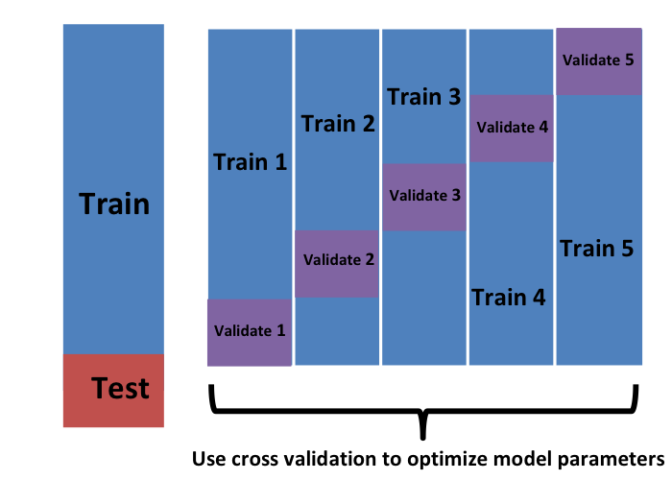
K – fold cross validation :

Slide 8
Why do we prefer using k-fold cross validation over other methods ?
Because there are important advantages of K-fold :
1. This runs K times faster than Leave One Out cross-validation because K-fold cross-validation repeats the train/test split K-times.
2. It is more accurate.
3. More “efficient” use of data as every observation is used for both training and testing.
It used mostly for cross validation.

